Slide 1
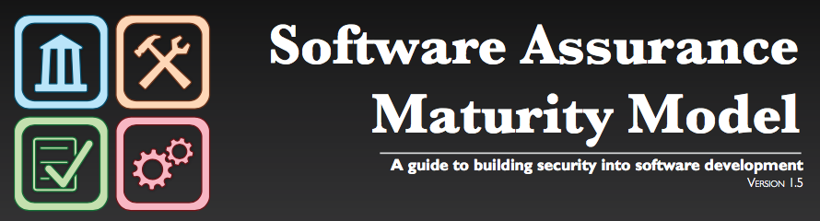
OWASP SAMM v1.5
Notes:
Good morning, my name is Brian Glas, I’m currently working as the Director of Strategic Services at nVisium, an application security consulting company based out of Virginia.
I’m the co-lead of OWASP SAMM and also the OWASP Top 10.
I’ve been working on SAMM for a number of years and have conducted many assessments for clients.
But you didn't come to spend your time listening about me, you want to know more about SAMM.

Slide 2
What is SAMM?
The Software Assurance Maturity Model (SAMM) is an open framework to help organizations formulate and implement a strategy for software security that is tailored to the specific risks facing the organization.
The resources provided by SAMM will aid in:
Evaluating an organization’s existing software security practices.
Building a balanced software security assurance program in well-defined iterations.
Demonstrating concrete improvements to a security assurance program.
Defining and measuring security-related activities throughout an organization.
Notes:
What is SAMM?
SAMM about trying to help you structure what you have/are doing and build a plan for how to improve software security
SAMM was defined with flexibility in mind such that it can be utilized by small, medium, and large organizations using any style of development. Additionally, this model can be applied organization-wide, for a single line-of-business, or even for an individual project.
SAMM is full of useful resources that will help with evaluating an organization's current practices, recommendations or suggestions for growing and maturing those practices, providing a way to demonstrate concrete improvements, and defining and measures security activities throughout the lifecycle.
One of the big benefits of SAMM is that it is vendor agnostic.
SAMM can be done in-house or you can have one of several appsec consulting firms help you with the assessment, goals, plans, roadmaps, etc.

Slide 3
Why SAMM?
”The most that can be expected from any model is that it can supply a useful approximation to reality: All models are wrong; some models are useful.” – George E. P. Box
Notes:
I like this quote from George Box, who has been called one of the great statistical minds of the 20th century.
<quote>
The point is that you can’t find a model that will exactly describe reality, there too many variables. Models are built in the academic world, we live in the real world.
But, you can have a model that is close enough to be useful, and that is what SAMM is.

Slide 4
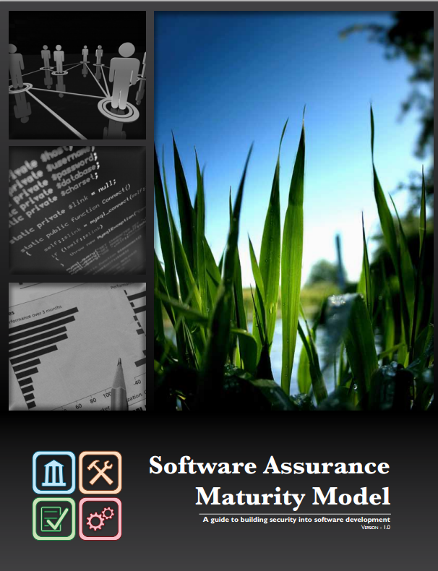
Core Principles of SAMM
An organization’s behavior changes slowly over time
Changes must be iterative while working toward long-term goals
There is no single recipe that works for all organizations
A solution must enable risk-based choices tailored to the organization
Guidance related to security activities must be prescriptive
A solution must provide enough details for non-security-people
Overall, must be simple, well-defined, and measurable
OWASP Software Assurance Maturity Model (SAMM)
Notes:
SAMM is built on a few core principles.
First, an organization's behaviour changes slowly over time. Changes need to be smaller and iterative to really take hold and make a difference.
Second, there is no single recipe that works for all organizations. SAMM is built with this in mind, and supports an organization building a program that is tailored to their risk profile, culture, IT maturity, etc.
Thirdly, Guidance related to security activities must be prescriptive. Too often, security initiatives fail due to poor details, lack of communication, or invalid assumptions.
Overall, the success of the program will be based on being simple, well-defined, and measurable.

Slide 5
Project History
OpenSAMM 1.0
OWASP SAMM 1.1
OWASP SAMM 1.5
OpenSAMM
OWASP SAMM 2.0
March 2016
February 2017
2018-2019
March 2009
Notes:
Version 1.0 of OpenSAMM was originally created through the OpenSAMM Project led by Pravir Chandra (chandra@owasp.org), an independent software security consultant. Creation of the first draft was made possible through funding from Fortify Software, Inc.
After a number of years, a small group got together at OWASP and worked together to breath some life into SAMM as an OWASP project.
Version 1.1 of SAMM expanded and restructured its predecessor into four complementary resources:
Core Document: that describes the core SAMM model
How-To Guide: that explains how to apply the model
Quick Start Guide: to help accelerate learning and adoption
Toolbox (spreadsheet): that provides simple automation for data collection, metrics, and graphs.
We’ve released v1.5 of SAMM which incorporates a refinement of the scoring model to provide more granularity to the scoring in an assessment. Now an organization will get credit for all the related work done in a practice rather than having the base number held at the highest completed maturity level.
We are actively working toward v2.0.
The updated scoring model has been designed to help SAMM assessors and organizations avoid the awkward discussion on whether to mark an answer yes or no when it is honestly something in between, and to show incremental improvements.

Slide 6
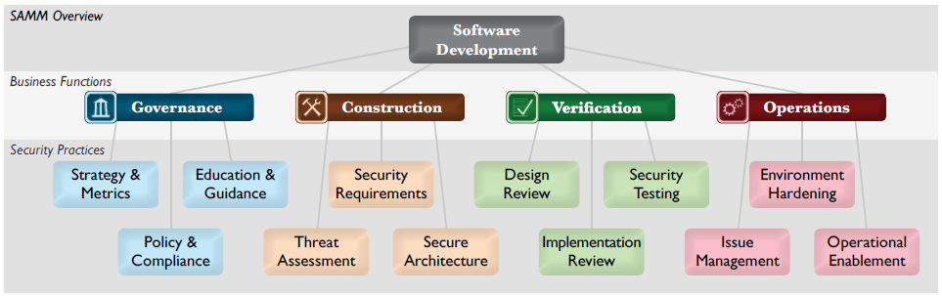
SAMM Framework
For each of the four Business Functions, three Security Practices are defined
The security practices cover areas relevant to software security assurance
Notes:
SAMM is defined in different levels.
At the highest level, SAMM defines four critical business functions. Each business function is a category of activities related to the nuts-and-bolts of software development.
For each business function, SAMM defines three security practices. Each security practice is an area of security-related activities that build assurance for the related business function.
For each security practice, SAMM defines three maturity levels as objectives. Each level within a security practice is characterized by a successively more sophisticated objective defined by specific activities, and more stringent success metrics than the previous level.
If you look at the framework, you can see that Governance is more focused on the program itself, looking at the more strategic elements, policy, education, etc.
Construction, Verification, and Operations cover the core of a development lifecycle. Construction is looking at design and implementation, Verification is more focused on the testing/verifying aspects, and Operations is issue management and infrastructure that the apps live on.

Slide 7




Maturity Levels & Assessment Scores
No
Few/Some
At Least Half
Many/Most
Ad-hoc provision
Comprehensive mastery at scale
Practice unfulfilled
Increased efficiency/effectiveness
Transparent view over different levels
Fine-grained improvements are visible
Notes:
No everyone needs to make level 3 in all areas.
Similar to six sigma or CMMI, the goal is not to max out every practice.
Honestly, that probably wouldn't be a good use of your limited resources.
What the target maturity should be for your organization is largely up to you.
Previously in SAMM and most models the questions are Yes/No, which is great from an academic perspective, but in the real world the answer many time lies in between the two.
In v1.5 we have modified the scoring model to provide multiple choice answers to allow for a more accurate assessment.
For example: answer the following question for Education and Guidance Level 2:
Are those involved in the development process given role-specific security training and guidance?
You know you have trained some of the developers and would like to train some project manager and testers.
But given the question, do you answer Yes or No?
If you answer no, you get no credit and it looks like you aren't working on it, but you are.
If you answer yes, you now get full credit and may have issues down the road asking for training budget for the other roles because the dashboard says you did it already.
With the new model, you can answer something like "some" or "at least half" and get that credit, but also have the ability to show improvements in your score when you finish the initiative to train the other roles.

Slide 8
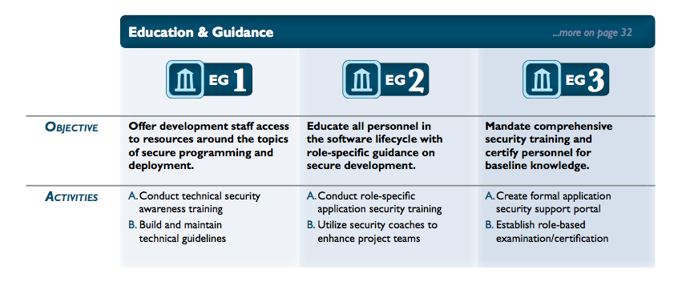
Example: Education & Guidance
Notes:
Let look at a snippet from the Education and Guidance practice within the Governance Function.
You can see the objectives and activities laid out for each maturity level.
The activities can build on each other, and many times do; but it's not a hard requirement because each org is different and may have different solutions.
You can see the objectives and activities get more advanced at the higher maturity levels.

Slide 9
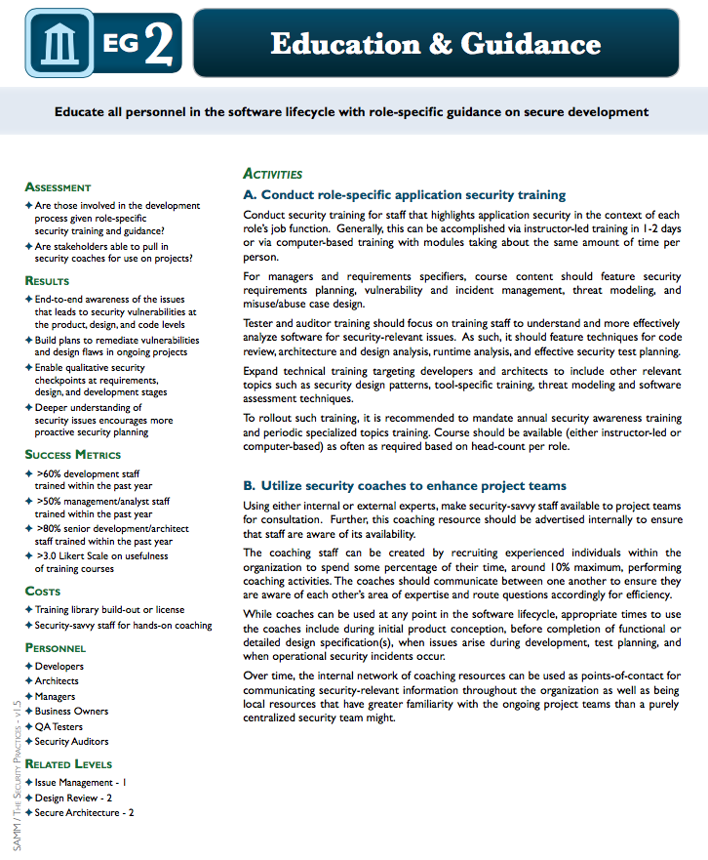
Level definitions...
Objective
Activities
Assessment
Results
Success Metrics
Costs
Personnel
Related Levels
Notes:
Here is an example definition of Maturity Level 2 for the Education and Guidance Security Practice.
These are defined for each of the three maturity levels for each of the 12 security practices.
Objective is simply defined
A couple of primary activities are spelled out with details and guidance details for those activities
Assessment questions that are in the interview questionnaire are listed
Expected Results that you should see from the completed activities
Suggested metrics to help get you started with tracking
Potential costs
Personnel that may be involved
And any potentially related levels of other security practices so you can see the relationships between the practices and influence

Slide 10
SAMM Quick Start
ASSESS questionnaire
GOAL gap analysis
IMPLEMENT resources
PLAN roadmap
Continuous Improvement
Iterative
Small Steps
Notes:
Use 4 step improvement iterations:
Measure levels => assessment QA
Set goals => gap analysis
Plan => Roadmap
Implement => with other OWASP material
And go back to 1)

Slide 11
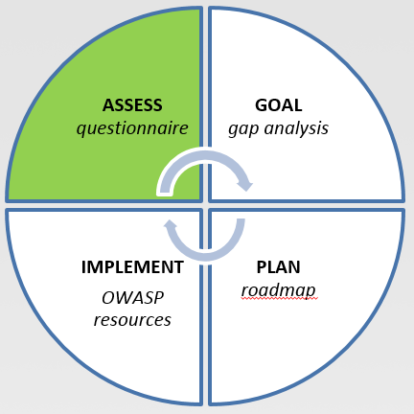
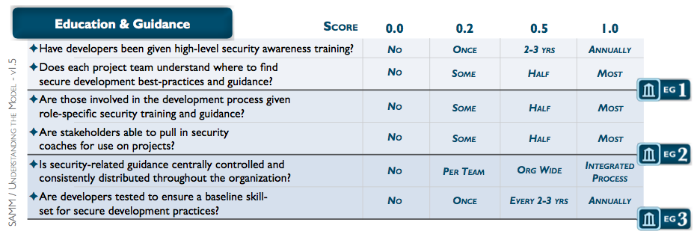
Assess via Worksheet
Notes:
How often you assess is up to you and your culture.
I’ve seen it range from once every couple years to continuous.
Can depend on how you run your program as well.

Slide 12
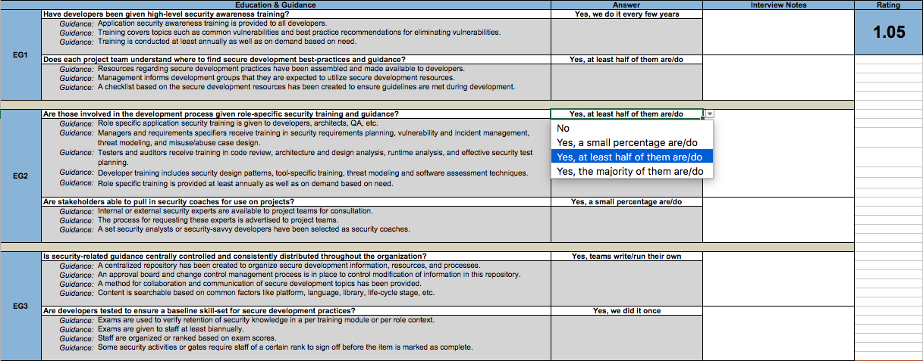
Assess via Toolbox

Slide 13
Assess – Best Practices
Build more targeted ”conversational prompts” for different roles:
Management, Architects, Developers, Analysts, Ops, etc.
Try different formats (interviews, workshops, etc.)
Validate results:
Repeat questions to several people
Aggregate gathered information
Notes:
You can just go down the list of questions in the document or toolbox, but that’s no fun.
Be a little more creative, be human.
Build conversational prompts tuned for each role type you talk with.
I recommend a “third-party” of some sort. Might be internal or external. There is just something different about how people will share with a neutral party.
You can do interviews, where you have those discussions/conversations
Or you could do a mini-workshop where you have a number of people answer the questions, then consolidate and discuss those answers
Repeat questions, you have a higher level of assurance that the answers are correct/accurate as they can be

Slide 14
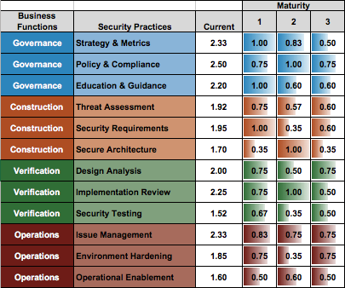
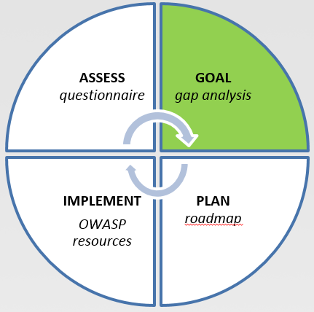
Goal
Gap analysis
Demonstrating improvement
Ongoing measurement
Notes:
As you are trying to build your goals, you can look at the scores you have from the assessment and the different activities for each maturity level.
Based on your organization, you would identify initiatives to undertake that would result in a changed or improved answer to one of the questions, which in turn incrementally improves the related maturity score.
You can see an example of this in the red boxes where the question "are developers tested to ensure a baselines skill-set for security development practices?"
When we completely the assessment, the answer was "we did it once", we put a plan in place that would perform this every other year so that at the end of phase 1, our maturity score would improve from 1.05 to 1.20.
You can also see through the next phases (green highlighted), the score is improving with the completion of projected activities.
Also note, that in this example they aren't totally completed in order, this is one of the features of SAMM to allow this flexibility.

Slide 15
Goal – Best Practices
Get consensus and management support
Be prepared with budget/LOE estimates
Think carefully about target SAMM level
So you want to achieve all 3’s. (I like your budget, can I have some?)
Respect practice dependencies
It can make sense not to include particular low-level activities

Slide 16
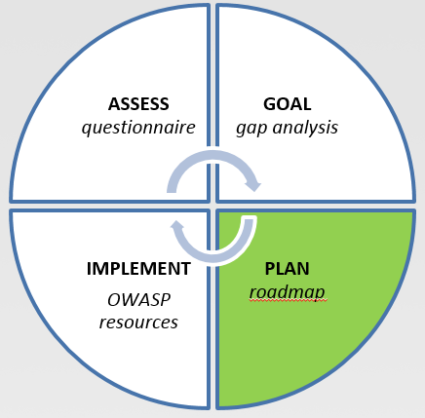
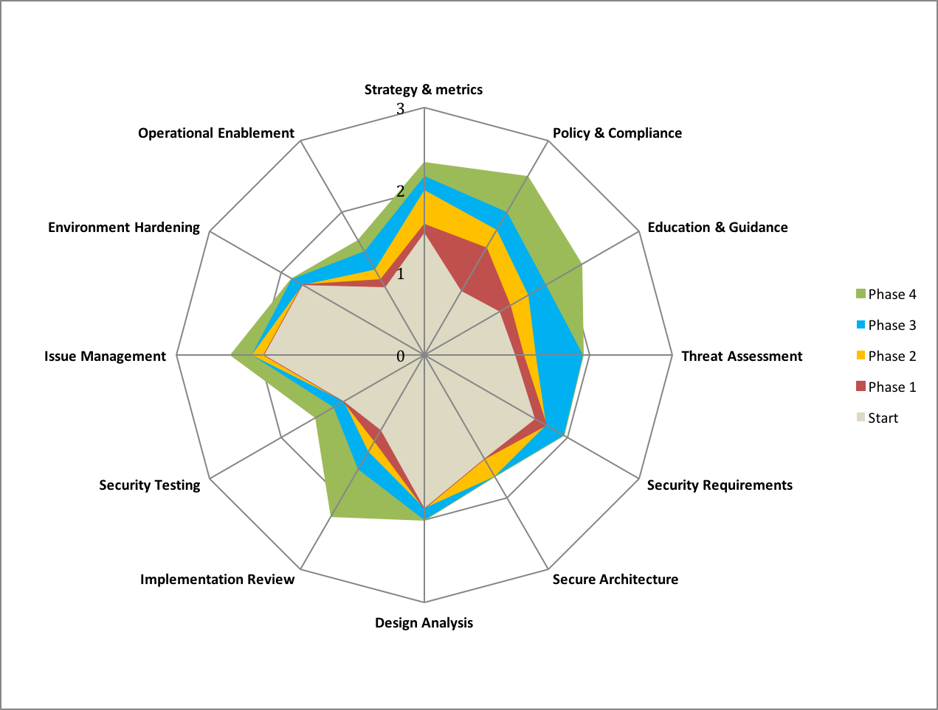
Plan
Roadmaps: use the “building blocks”
Templates for typical kinds of organizations
Tune these to your own targets / speed
Notes:
SAMM provides example templates for a few different types of organizations to start from. And also provide details for different activities or building blocks for planning out a roadmap.
These are tuned or tailored for your organization.
As a result, you can start to build diagrams like this to visually see your projected progress as you would complete these initiatives.

Slide 17
Plan – Best Practices
Identify quick wins (Need short, mid, long term targets)
Start with awareness / training / expectations
Adapt to upcoming release cycles / key projects
Spread effort & “gaps to close” over realistic iterations
Spread work, roles, & responsibilities
AppSec resources, development, security, operations
For instance service portfolio and guidelines: when and who ?
Take into account dependencies

Slide 18
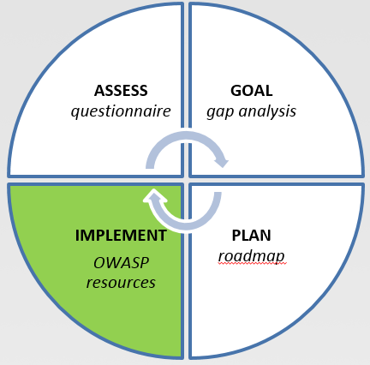
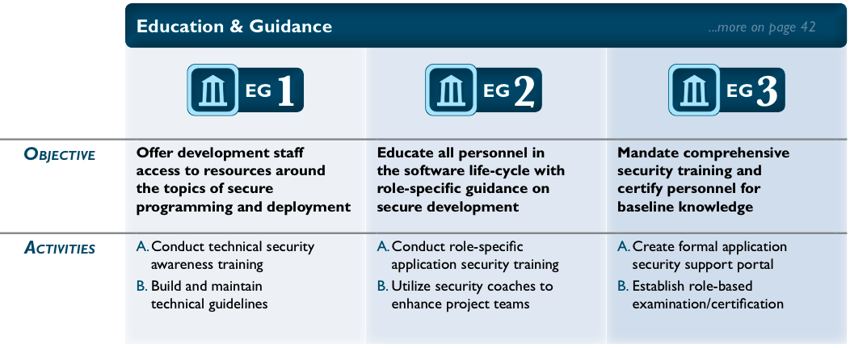
Implement: 150+ OWASP resources
WebGoat, iGoat, GoatDroid, AppSec Tutorials, Top Ten
Hackademic Challenges
Red Book
Development Guide
Cheat Sheets
Quick Reference Guide
Education Testing Guide
Notes:
In implement, you may have internal resources, you can also use OWASP and may other online resources to help build that knowledge base.
Also recommend looking at automating what makes sense. Today a lot of the technical guidelines can be built into developer IDEs so they are reminded of them while they are in the middle of coding your applications.

Slide 19
Implement – Best Practices
Categorize applications: High, Medium, Low based on risk: e.g. Internet facing, transactions, ...
Recheck progress & derive lessons learned at each iteration
Create & improve reporting dashboard
Application & process metrics
Treat new & legacy code bases differently
Balance planning on people, process, knowledge, and tools

Slide 20
Critical Success Factors
Get buy-in from stakeholders
Adopt a risk-based approach
Awareness & Education is the foundation
Integrate & automate security in your development, acquisition, and deployment processes
Measure: Provide Management Visibility

Slide 21
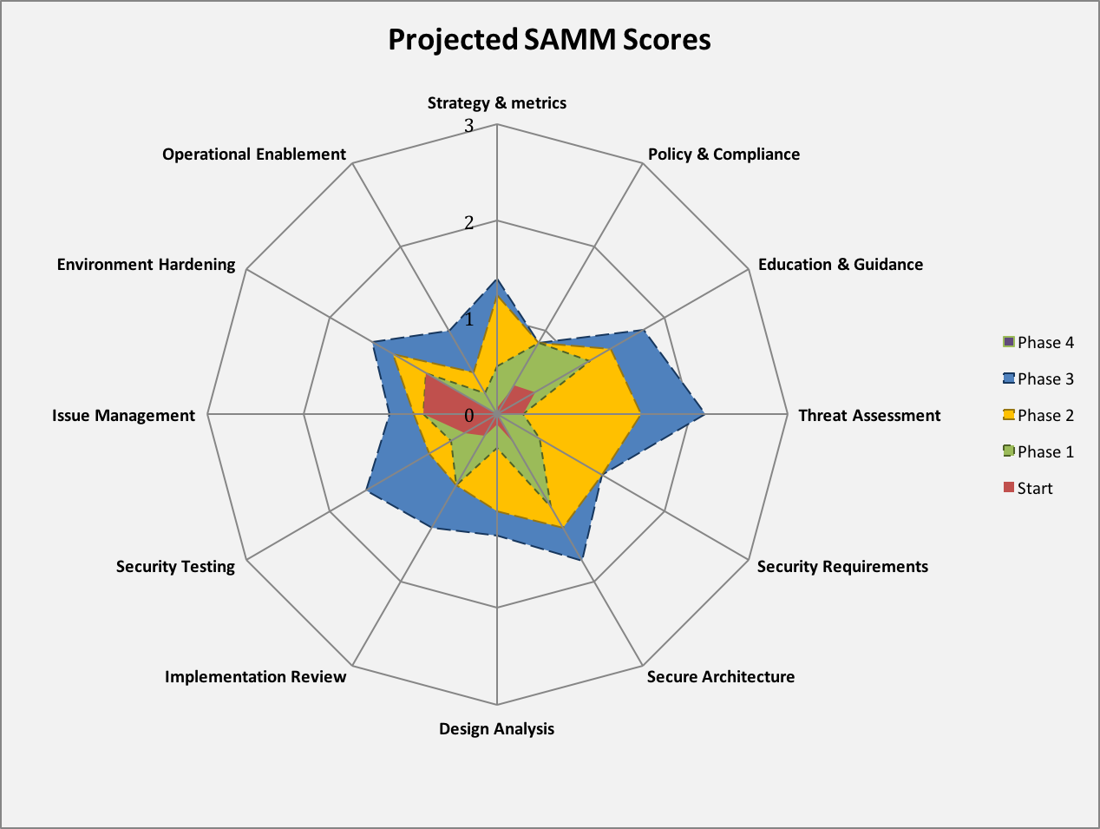
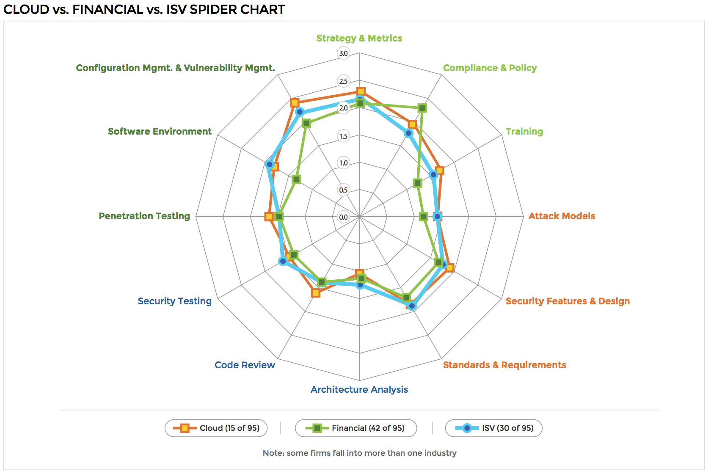
SAMM can map to BSIMM
SAMM
BSIMM

Slide 22
SAMM Project Roadmap
v2.0 (In Progress):
Model revision
More Metrics!
Application to agile/devops
Roadmap effort planning
Benchmarking
Build the community:
Grow list of SAMM adopters
Workshops at conferences
Dedicated SAMM Summit
Contribute Anon Results

Slide 23
OWASP Summit 2017
Restructure SAMM activities with an increasing maturity of implementation
Apply this restructure exercise to all SAMM practises and activities (high level).
Create one or more detailed descriptions with implementation guidance.
Modernize the more traditional language and terminology.

Slide 24
*** Under Consideration for V2.0 ***
SAMM
Overview
Software Assurance
Lifecycle
Business
Function
Governance
Design
Build & Deploy
Verification
Operations
Security
Practices
Strategy & Metrics
Threat Assessment
Secure
Build
Design Analysis
Incident Management
Policy &
Compliance
Security
Requirements
Secure
Deployment
Implementation
Review
Environment
Hardening
Education &
Guidance
Secure
Architecture
Defect
Management
Security
Testing
Operational
Enablement
Notes:
Explore adding a fifth business function to the SAMM Model
Missing activities for secure build
Operations does not cater for deployment
Issue management is not covering defect management

Slide 25

Get involved
Project mailing list / work packages
Use and donate (feed)back!
Donate resources
Sponsor SAMM

Slide 26
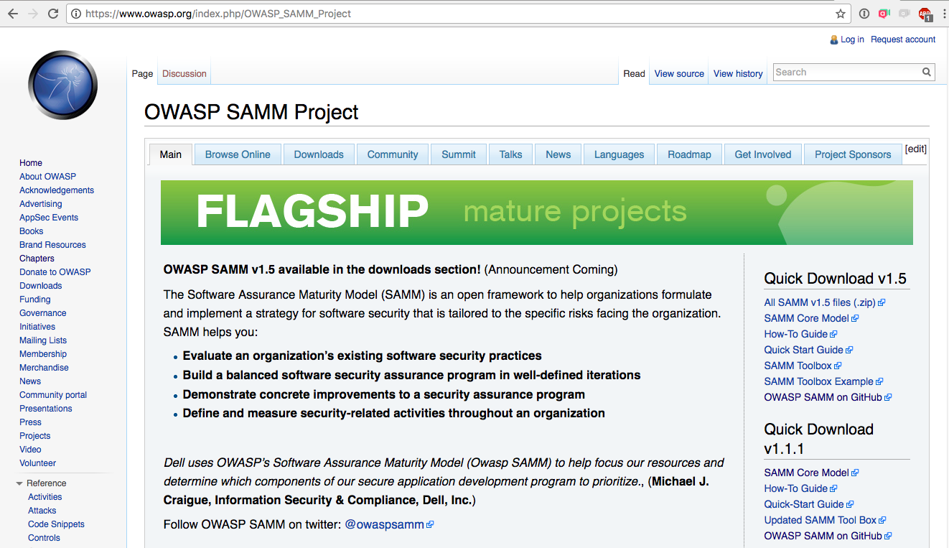
Notes:
OWASP SAMM Wiki
Downloads
Resources
Community
Talks
etc.

Slide 27
Thank you!
Questions?
brian.glas@owasp.org
Notes:
That's all that I had for today, so I'll turn it back over to Ken.

Slide 28
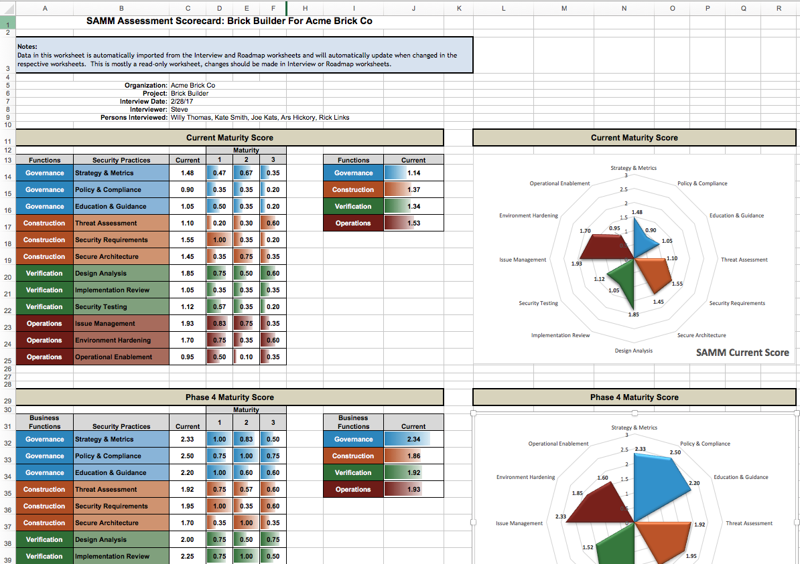
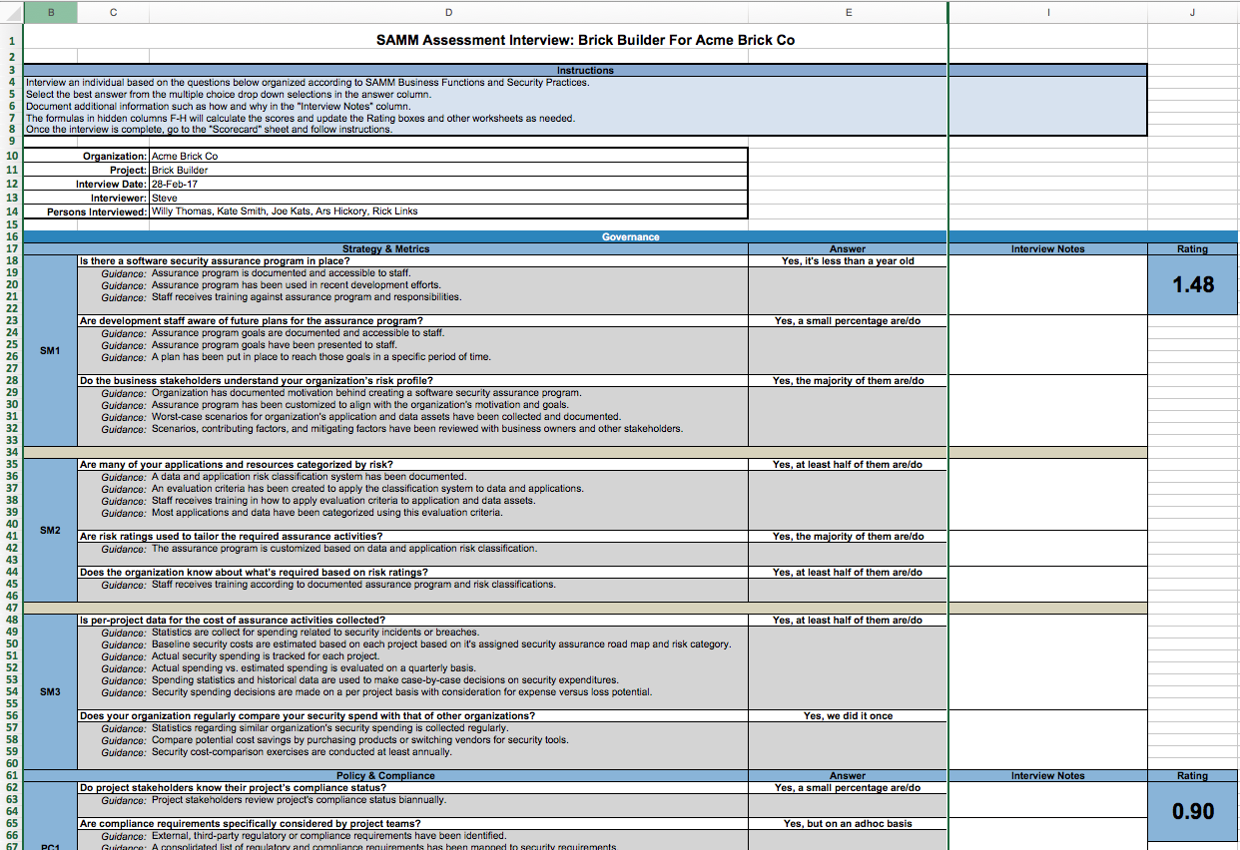
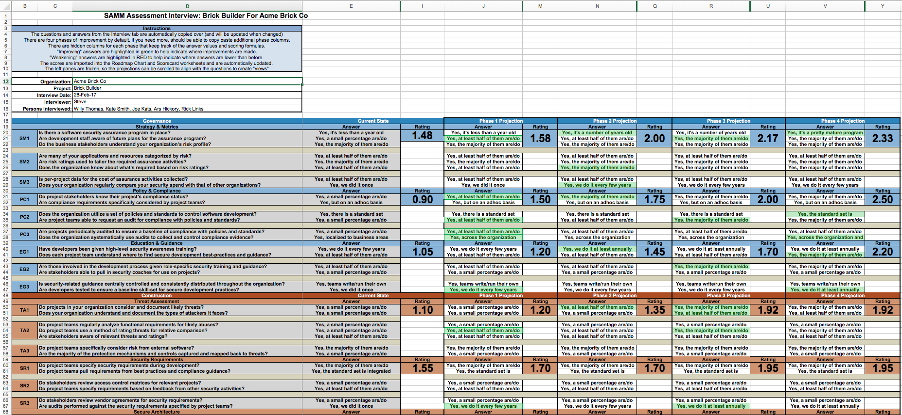
SAMM Toolbox
Notes:
Mentioned the SAMM toolbox a few times and wanted to show you a few things it can do. This is the interview worksheet.
When the worksheet is completed, you can look at the scorecard
Shows you coverage in each of the maturity levels for each security practice.
Plus overall for each business function

